Slide 1
Speech
Teoh Teik Toe
ITOM/NBS
ttteoh@ntu.edu.sg
97905202

Slide 2
Recording
https://1drv.ms/v/s!Aik2a4x7tvLyi-APe7RktLn5py2yBw?e=yuyBvL

Slide 3
Topics
Introduction to Speech
Deep Learning on Speech
Code: https://drive.google.com/drive/folders/1fXjR7HWQVDvW4b_UwFmEM_NymlOo4Wbw?usp=sharing
Data:
https://drive.google.com/drive/folders/1DWSSkL9zMwXktar8rxC_3rUGqxwNNTrR?usp=sharing

Slide 4
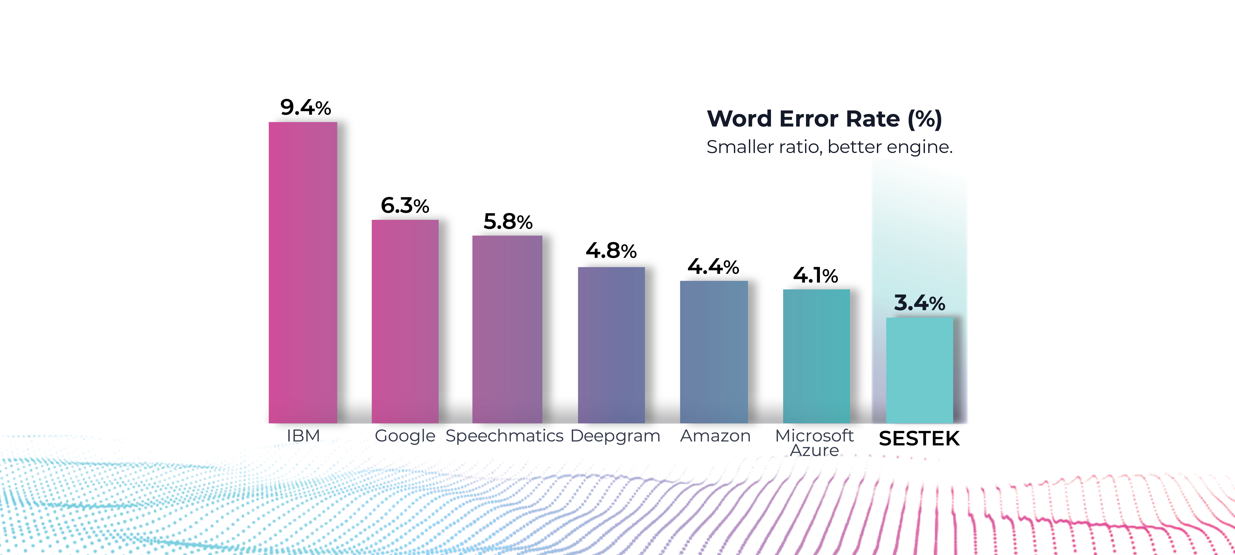
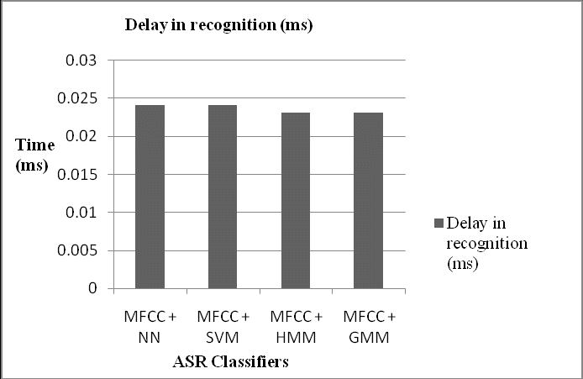
Unstructured Data - Speech
Current systems have vocabularies of 50,000 words or more. Error less than 3%. Lag 0.02ms.
https://www.sciencedirect.com/topics/immunology-and-microbiology/automatic-speech-recognition#:~:text=Early%20systems%20had%20recognition%20vocabularies,of%2050%2C000%20words%20or%20more.

Slide 5
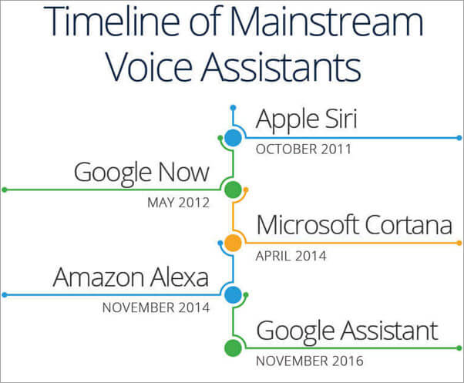
Top Speech Recognition Brand

Slide 6
Speech Format
48khz 16bit => 1 sec will have 48 x 1000 x 2 bytes (16bits) = about 10k byte and 10sec about 100kbyte without compression
A Normal Photo (about 1000 x 1000) pixel RGB (Color) Photo will be 1,000 x 1,000 x 3 byte, about 100k byte without compression
How strong is compression? Depends……
Frequency domain like jpeg will reduce up to 95%.

Slide 7
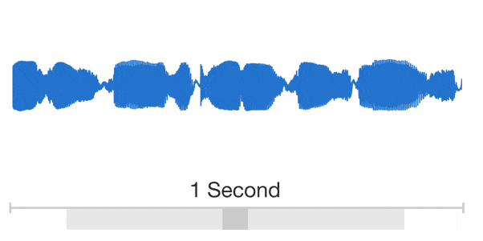
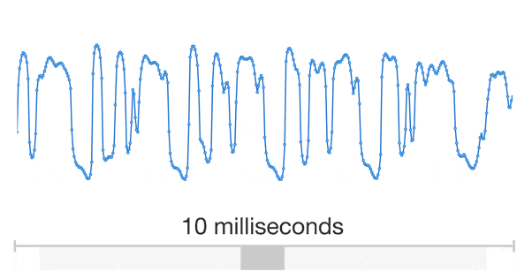
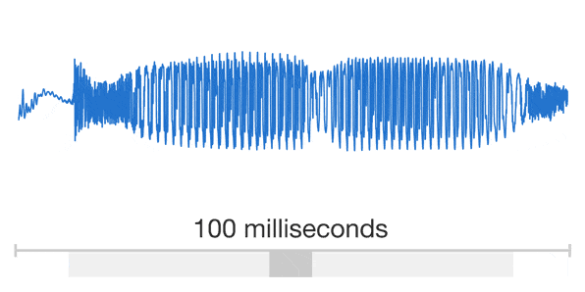
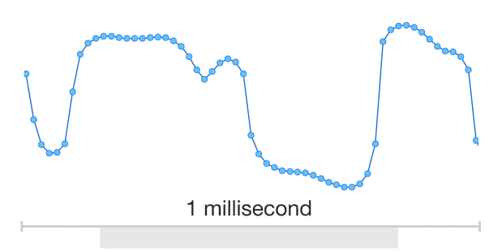

Slide 8
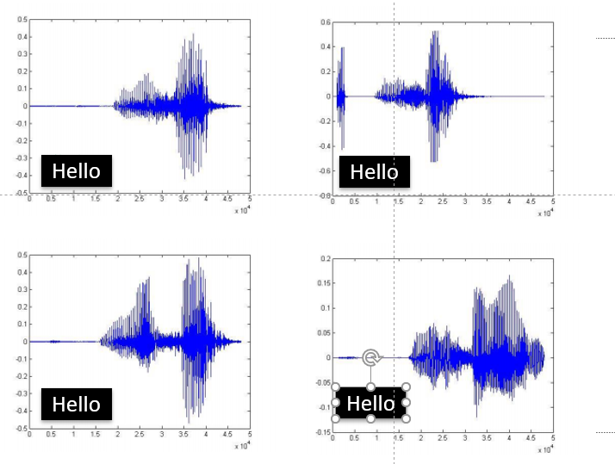
Speech is similar but not exactly the same
Hello
Hello
Hello
Hello

Slide 9
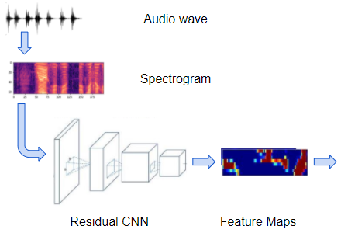
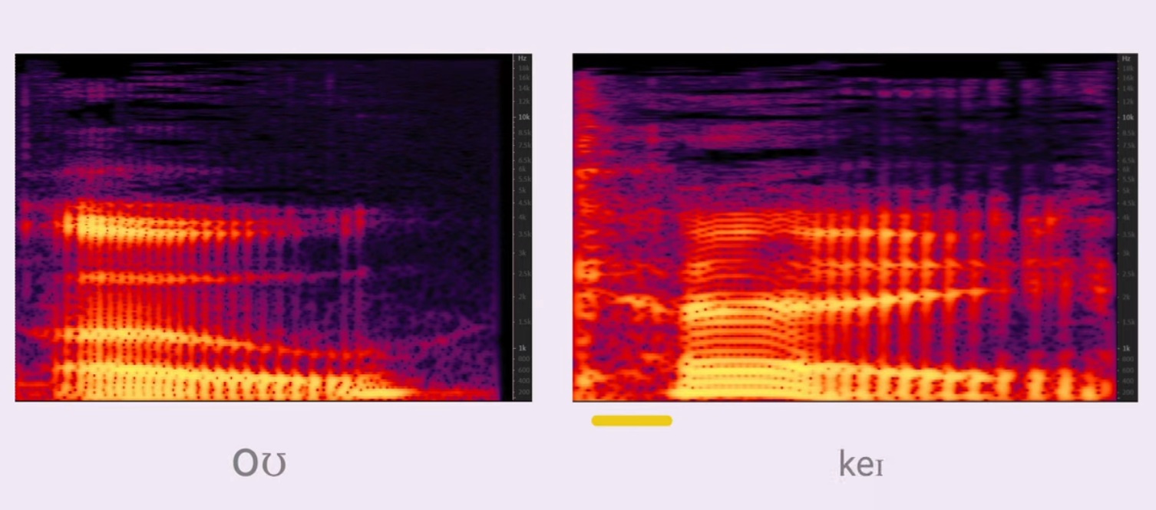
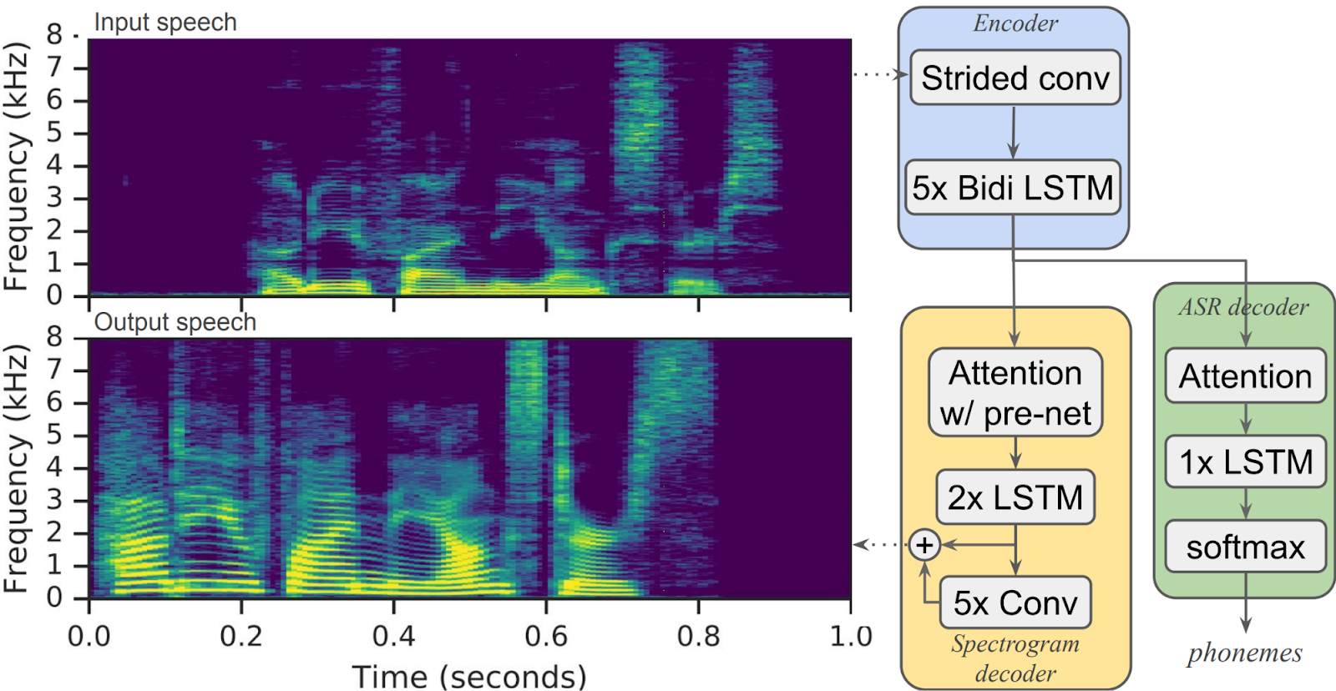
Speech
spectrogram

Slide 10
Perceptron Example
2
.5
1
.3
=-1
2(0.5) + 1(0.3) + -1 = 0.3
Learning Procedure:
Randomly assign weights (between 0-1)
Present inputs from training data
Get output O, measure the difference, adjust weights
Repeat; stop when no errors, or enough epochs completed

Slide 11
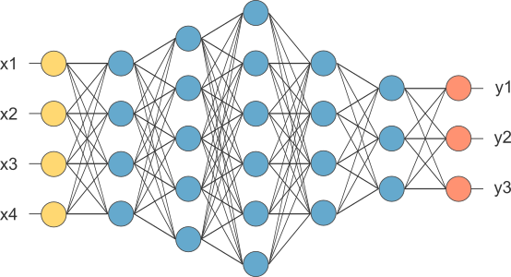
MLP
This is our fully connected network. If x_{1 .}... x_{n}, n is very large and growing,
this network would become too large. We now will input one x_{i} at a time,
and re-use the same edge weights.

Slide 12

Recurrent Neural Network

Slide 13
Speech Recognition (.wav)
To read:
import winsound
winsound.PlaySound("Welcome.wav", winsound.SND_FILENAME)
#pip install SpeechRecognition
#May need to upgrade pip : python -m pip install --upgrade pip (conda prompt)
pip install SpeechRecognition
import speech_recognition as sr
a = sr.AudioFile("/content/drive/MyDrive/TT Library/AI Model/Data/Welcome.wav")
with a as source:
a = sr.Recognizer().record(source)
r = sr.Recognizer().recognize_google(a)
r
https://colab.research.google.com/drive/1AG7fkCYo6bQ7I52qm-WbzAVAU6gEPA4X?usp=drive_link
Sample Wave file https://www.voiptroubleshooter.com/open_speech/american
With statement is same as :
Try, Except, Else, Finally

Slide 14
Speech to Text (MicroPhone) – Not in Colab – best to have microphone
#pip install SpeechRecognition
#pip install pyaudio
#pip install pyttsx3
!pip install PyAudio
import speech_recognition as sr
print("Accessing Microphone..")
with sr.Microphone() as source:
sr.Recognizer().adjust_for_ambient_noise(source, duration=2)
print("Waiting for you to speak...")
audio = sr.Recognizer().listen(source,timeout=3)
try:
print("You said " + sr.Recognizer().recognize_google(audio))
except:
print("Please retry...")
Sometimes you may need
#pip install pipwin
#pipwin install pyaudio

Slide 15
Text to speech
pip install pyttsx3
import pyttsx3
model = pyttsx3.init()
model.say("hi how are you")
model.runAndWait()
#for mac
import os
os.system("say how are you")

Slide 16
Combine
with sr.Microphone() as source:
sr.Recognizer().adjust_for_ambient_noise(source,duration=2)
print("waiting for you to speak")
model.say("Please say something")
model.runAndWait()
au2 = sr.Recognizer().listen(source)
try:
r2 = sr.Recognizer().recognize_google(au2)
r2 = "You have just said " + r2
print(r2)
model.say(r2)
model.runAndWait()
except:
print("please retry......")

Slide 17
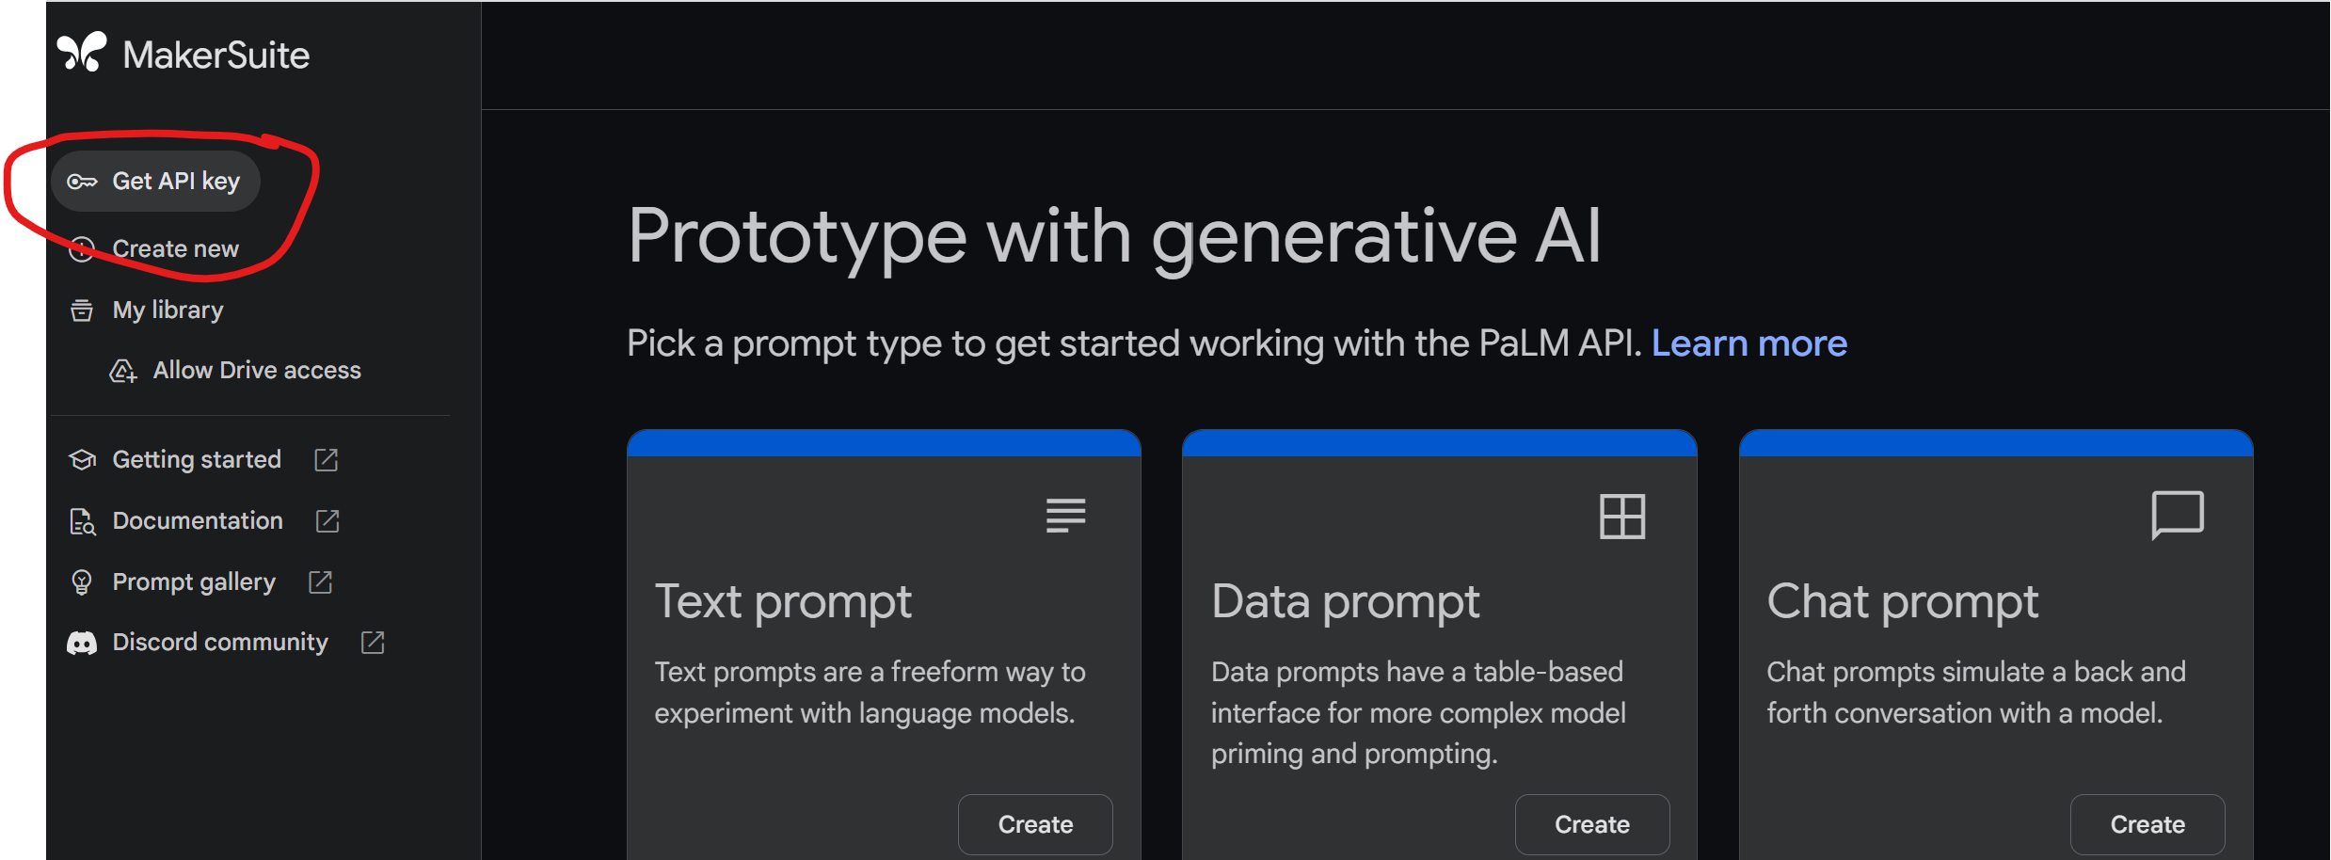
Google makersuite - https://makersuite.google.com/app/home

Slide 18
Google - gemini
pip install google-generativeai
import google.generativeai as genai
import os
from google.colab import userdata
api = userdata.get('makersuite')
genai.configure(api_key=api)
model = genai.GenerativeModel("gemini-1.5-flash")
response = model.generate_content("describe singapore.")
print(response.text)

Slide 19
Voice trigger ChatGPT (Anaconda)
import speech_recognition as sr
import pyttsx3
import google.generativeai as genai
model = pyttsx3.init()
genai.configure(api_key="")
m = genai.GenerativeModel("gemini-1.5-flash")
with sr.Microphone() as source:
sr.Recognizer().adjust_for_ambient_noise(source,duration=2)
print("Waiting.......")
model.say("How can I help you")
model.runAndWait()
au = sr.Recognizer().listen(source, timeout=5, phrase_time_limit=10)
try:
q = sr.Recognizer().recognize_google(au)
q1 = "You said :………………. "+ q + "………………….Please wait for a few seconds…….. "
model.say(q1)
model.runAndWait()
print(q1)
r = m.generate_content(q)
model.say(r.text)
print(r.text)
model.runAndWait()
except:
print("Please retry")
IN ZOOM, YOU NEED TO SHARE SOUND

